Slide 1
Fintech: Choosing a Cloud Services Provider
By: Montez Bell, Wonik Kim, and Venkat Sai Nag Bhargav Sabbineni

Slide 2
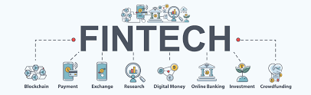
Background
Founded in 1991 with its EFTPS system serving clients in the beverage industry
Fintech developed an electronic fund transfer payment system (EFTPS)drastically simplifying tax reporting for its clients and enabling an invoice payment platform for wholesalers and retailers.
Joe Kwo, the CIO of Fintech, which is a billing and payment service for the alcoholic beverage industry. Kwo, is trying to decide which cloud service provider is the best one to use. Kwo talks with his staff and the decision is to choose between Microsoft, Amazon and Google.

Slide 3
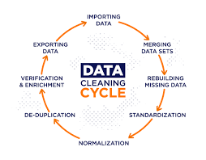
FINTECH: IT Capabilities
Already had an extensive data cleaning and integration system in place to record transactions which could be used for analysis
Copied data from transactions database to a warehouse for analysis and backup
Used both proprietary and locally customized software
Used a “conservative yet flexible” approach when developing/purchasing software services
Occasionally worked with consultants having expertise in niche areas

Slide 4
Question
How would a move to the cloud make it easier and/or more profitable for Fintech to provide large volumes of selected data to its clients?

Slide 5
Why Cloud?
Desire to exert technology leadership through cloud computing enabling valuable data insights that would strengthen Fintech’s relationship with customer
Types of Cloud Service
Infrastructure as a Service (IaaS) A third party hosts elements of infrastructure, such as hardware, software, servers, and storage, also providing backup, security, and maintenance.
Software as a Service (SaaS) Using the cloud, software such as an internet browser or application is able to become a usable tool.
Platform as a Service (PaaS) The branch of cloud computing that allows users to develop, run, and manage applications, without having to get caught up in code, storage, infrastructure and so on.

Slide 6
Question
What are some challenges Fintech faces in considering a cloud service provider?

Slide 7
Challenges faced by Fintech in the Case
The first challenge was the security aspect of the cloud services
A second challenge was hiring the right I.T. staff for the new technology because Fintech will need long-term staff to maintain and support the cloud service.
A third challenge was deciding which cloud service offered the best affordable database cost per month.
Fourth challenge was the company also had to train current I.T. staff members on the new cloud based system. Fintech researched what Google, Microsoft Azure, and Amazon offered for I.T. training. Microsoft Azure, Google, and Amazon all offered training and credentials including Amazon AWS solution architect and Developer associate, Google Cloud certifications, and Microsoft Solutions Architect.

Slide 8
Evaluation Criteria

Slide 9
Evaluation Criteria
Training
System Administration Support
Customer Support
Data and System Availability
Security
Programmability

Slide 10
Risk Analysis
Asset Identification
Reputation Brand
Software and Data Customer PII Electronic fund Transfer Payment System (EFTPS) Email, Websites Proprietary Software Local custom packages Database
Third-Party Vendors
Payment Financial Data
Employees
Notes:
Asset – something that you have that is of value to your organization – physical or virtual (perceived values)

Slide 11
Risk Analysis
Threats
Data Breach
Compromised Credentials
Hacked interfaces and APIs
Cloud Service Abuse (DDoS attacks, APT Parasites, phishing attempts, email spam, digital currency "mining")
Data loss
Shared technology, shared dangers
Vulnerabilities
Infrequent Data backups
Data Integration
Legacy Applications/Proprietary Software
Separate copies of data requirements
Time constraints for regulations
Notes:
Asset – something that you have that is of value to your organization – physical or virtual (perceived values)

Slide 12
Risk Analysis
Threat/Impact Area | Controls
Cloud Service Abuse | Redundancy / Failover System (Route 53)
Hacked interfaces and APIs | Two Factor Authentication
Data Breaches | Data Encryption,
Compromised credentials | Role base access controls (RBAC), 2FA
Data loss | Data Standardization
Shared Technology, Shared Dangers | A framework of security policy for integrators

Slide 13
Qualitative/Quantitative Analysis
Impact Area (Ranked) | Probability (1: Least – 6 Most Likely) | Business Impact | Value (1-3 Low-High) | Risk Score | Risk Ranking (Decision)
Cloud Service Abuse | 6 | High | 3 | 18 | Transfer
Hacked interfaces and APIs | 5 | High | 3 | 15 | Mitigate
Data Breach | 3 | High | 3 | 9 | Mitigate
Compromised Credentials | 4 | Medium | 2 | 8 | Mitigate
Data loss | 2 | Medium | 2 | 4 | Mitigate
Shared technology, shared dangers | 1 | Low | 1 | 1 | Accept

Slide 14
Weighted Factor Analysis
Threats:
Criteria | Criterion 1: Frequency of Attack (0-1.0) | Criterion 2: Reputation loss if successful (0-1.0) | Criterion 3: Financial loss if successful (0-1.0) | Weighted score
Criterion Weight (1-100) | 20 | 45 | 35 | 100
Cloud service abuses | 0.4 | 0.8 | 0.7 | 68.5
Hacked interfaces and APIs | 0.8 | 0.6 | 0.5 | 60.5
Data Breach | 0.5 | 0.5 | 0.4 | 46.5
Shared Technology, Shared Dangers | 0.2 | 0.4 | 0.5 | 39.5
Data loss | 0.3 | 0.4 | 0.4 | 38

Slide 15
Cost Benefit Analysis
Controls
AWS for $19,656 annually, which reduces SLE by 25%
Microsoft Azure for $87,612 annually, which reduces SLE by 25%
Google Cloud for $20,208 annually, which reduces SLE by 20%.
CBA = Present Value of Future Benefits / Present Value of Future Cost
AWS: 2.52
Microsoft Azure: 0.80
Google Cloud: 2.46

Slide 16
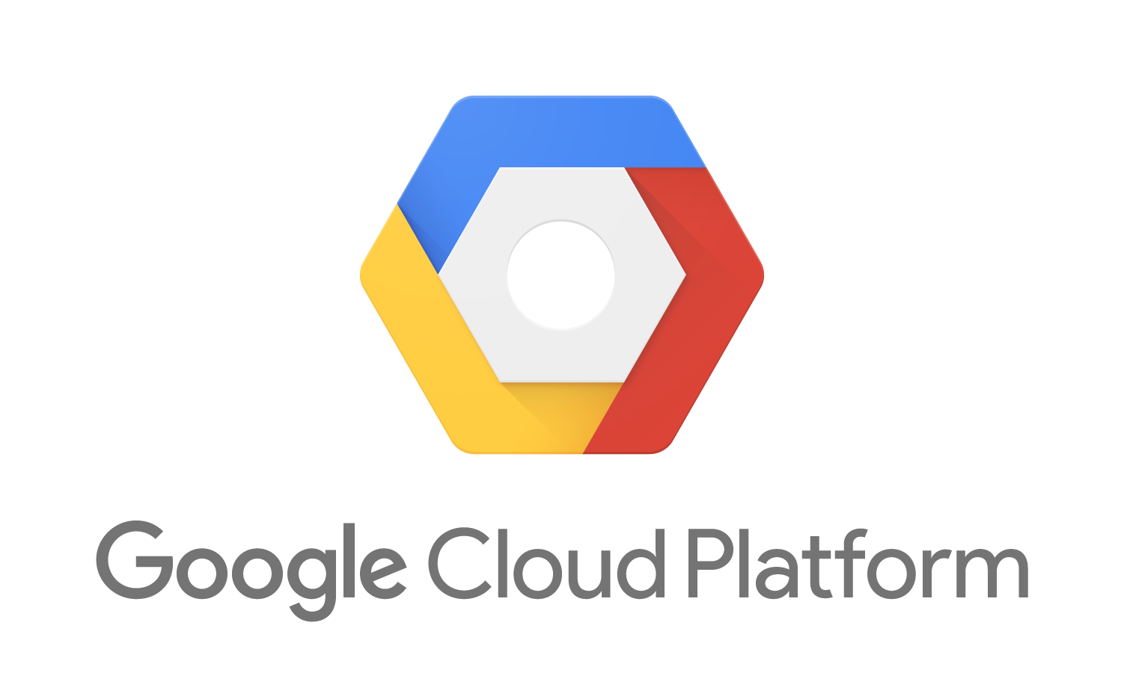
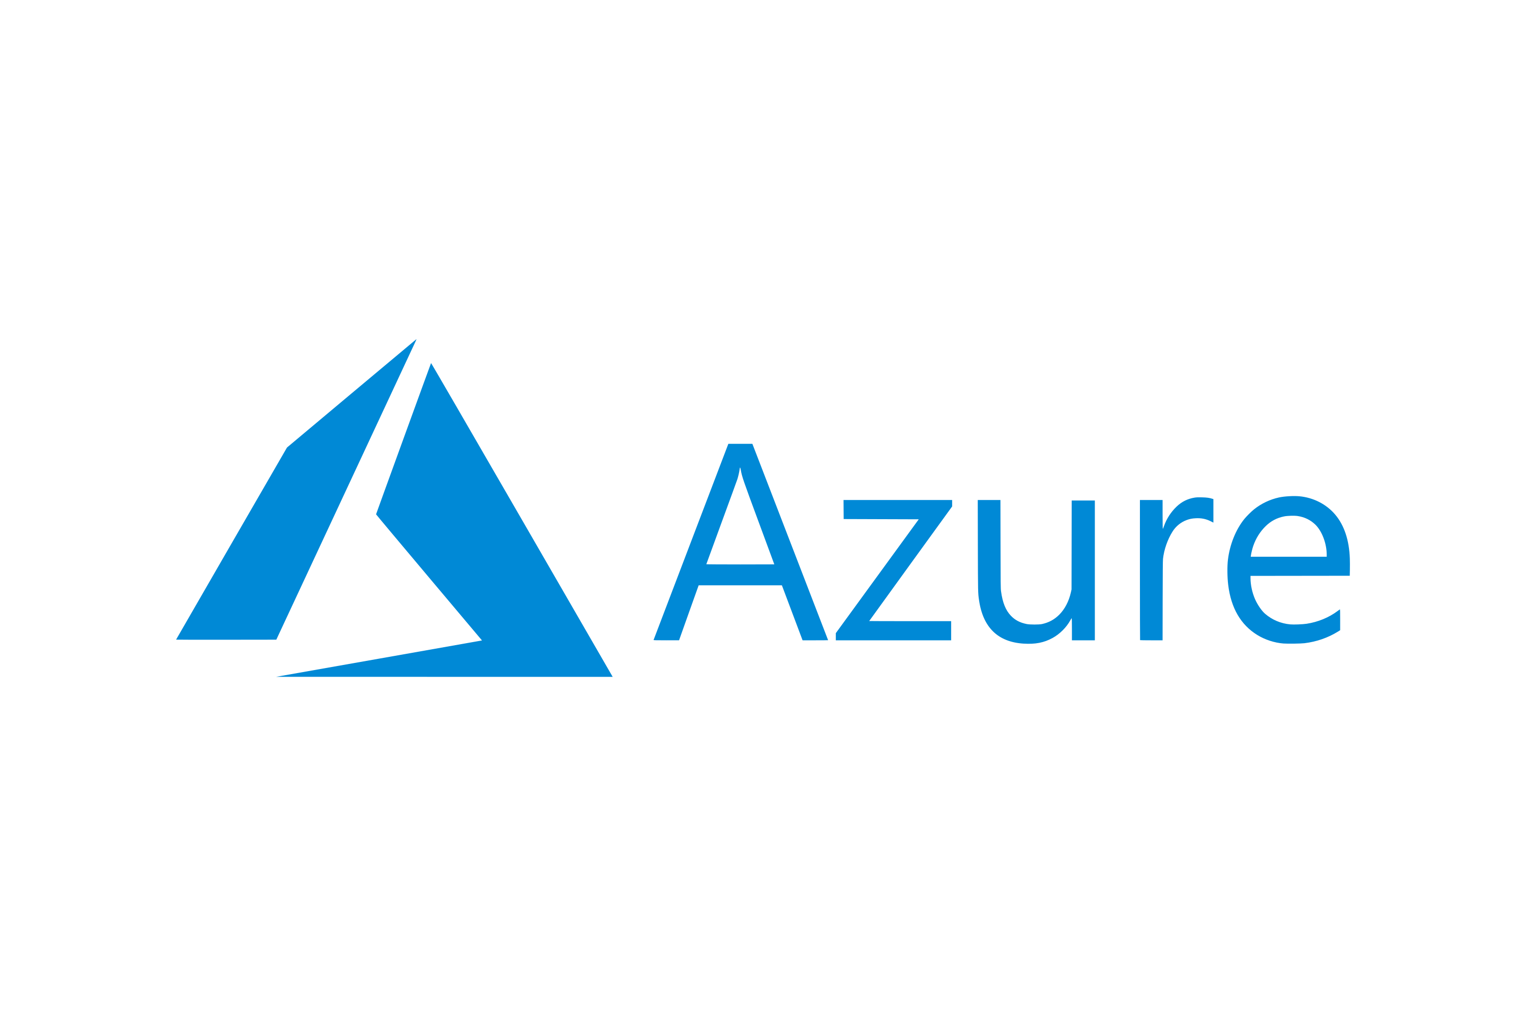

Cloud Service Providers
Google
Launched in 2008 by Google
available in 29 regions, 88 zones, and 200+ countries
Offers over 90 services to businesses, ranging from computing and storage tools to analytic and networking tools.
Azure
Launched in 2010 by Microsoft
Spread across 58 regions with dedicated infrastructure each and is available in 140 countries/regions
Has in-built over 200 products and services from multiple categories: from AI and Machine learning and Developer tools to Hybrid cloud, Internet of Things, Mixed Reality, and Networking.
AWS
Launched in 2006 by Amazon
Spans 26 regions and 84 availability zones and works in over 245 countries.
Can handle almost every business need, including computing, databases, infrastructure management, application development, and security.

Slide 17
Question
Assume Joe Kwo must choose a cloud service provider based on the information in the case. Which provider should Joe choose?

Slide 18
Recommendation
Amazon Web Services
Benefits:
1. One Click Regulation and Compliance 2. Low cost 3.Fast and Secure Data backup 4. Scalability and Performance 5. 24 Hours availability 6. Encourage Devops Culture
Future Considerations:
Current state of cloud computing, there has been a significant change in the storage cost, billing models, and overall security certifications that the three main providers possess
Most of the fintech organizations are moving to multi-cloud environment by preferring characteristics of each cloud platform.

Slide 19
Conclusion
Companies across industries are moving or expanding their footprint on Cloud.
Massive technological improvements and cost advantages can be achieved with cloud based solutions.
Businesses are collecting huge amount of data and it can be used to generate insights that can be turned into profits for a business.
Fintech will benefit both aspects of technology and business with move to Cloud.

